Slide 1
Processing
Lecture. 1
What is processing?
lbg@dongseo.ac.kr

Slide 2
INDEX
Lecture plan
Processing?
How to set up?
Do it : Simple example(Drawing)
Homework

Slide 3
Lecture plan

Slide 4
Lecture Plan
What is Processing + Simple drawing
Mouse + Keyboard input event
Loop and animation
Processing + Kinect
Flash + Kinect

Slide 5
Processing?

Slide 6
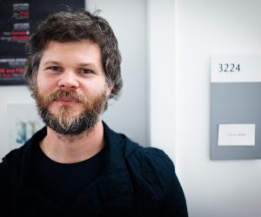

Processing?
History
  2001, Initiated in MIT Media Lab
  Co-Developer : Casey Reas, Benjamin Fry
    Both formerly of the Aesthetics and Computation Group at the MIT Media Lab
Casey Reas
Benjamin Fry
Artist, Professor, Software developer
Artist, Psychotherapist, author, broadcaster

Slide 7

Processing?
Digital Sketchbook!
  Open source programming software
    For non-programmers started with programming, artists, designers, researchers, hobbyists..
    It means easy to use anybody!
  Conclude with simple code & function
    visual context(point, line, rectangle, circle…), picture, movie..
  Electronic arts, Visual design, etc..
  It is digital sketchbook!
    We can draw anything

Slide 8
Processing?
IDE(Integrated Development Environment)
  Java compiler
    Language builds on the Java
    But, uses a simplified syntax and graphics programming model
    All additional classed defined will be treated as inner classes
    When compile the source code, translated into pure Java before compiling
  Possible to add other libraries at sketch project
    Easy to add other library
    Ex) Kinect Library, simpleML, etc..
  Windows, Mac, Linux support
    Depends on users what machine we have

Slide 9
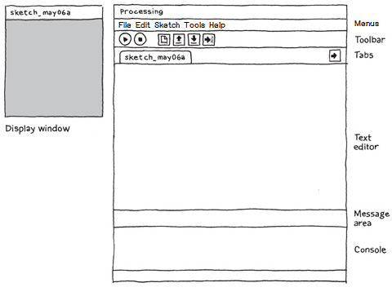
Processing?
System composition
  Sketch
    Project called sketch
  Big 3 parts
    Text editor
    compiler(Java compiler)
    A display window

Slide 10
Processing?
Menus
  Totally 5 menus
    File, Edit, Sketch, Tools, Help
  File
    Options for manage the sketch
  Edit
    Options for modify the sketch codes
  Sketch
    Options for execute the sketch
  Tools
    Set sketch’s property
  Help
    Open references, samples, link to Processing webpage

Slide 11
Processing?
Toolbar
  6buttons in here
    Run, Stop, New, Open, Save, Export
  Run
    Compile the code
    Pop up the display view
    Execute the program
  Stop
    Stop the executed program
    But, Not destroy the display view
  New
    Create a new sketch

Slide 12
Processing?
Toolbar
  6buttons in here
    Run, Stop, New, Open, Save, Export
  Open
    Open the exist sketch to IDE
  Save
    Save the current sketch to current path
    Save to another path, go to “File menu” and choose “save as”
  Export
    Convert sketch to Java applet

Slide 13
Processing?
Text editor
  This region is Sketch
    Input source code here
    Make functions
    Load library
    We can do anything here
Message & Console area
  Show some result message
    Error or success message
Display window
  Show the result region
    We can show the result at here
    Possible to fix the size at Text editor

Slide 14
What
can we do?!

Slide 15
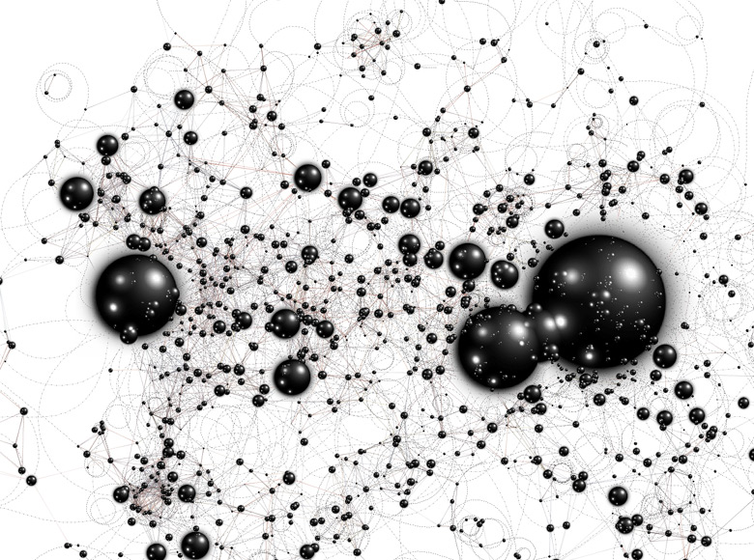

Slide 16
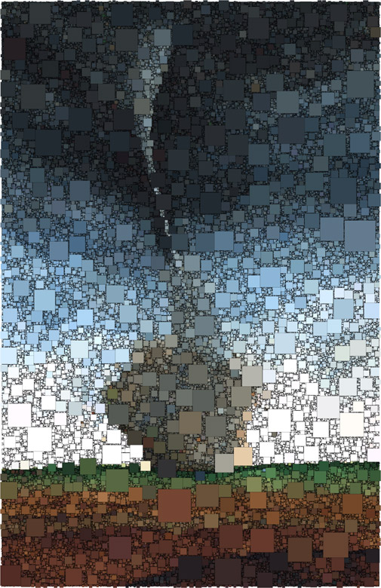

Slide 17
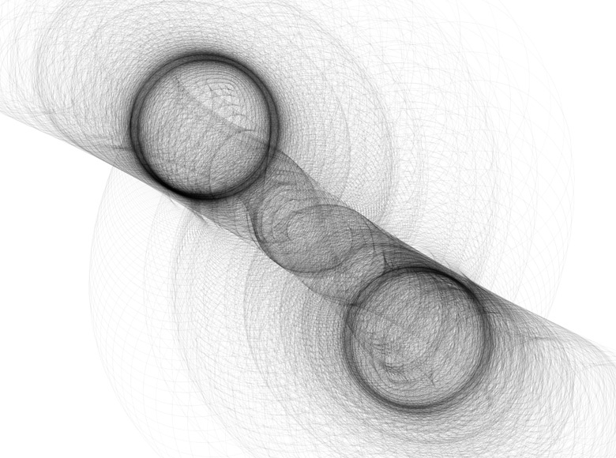

Slide 18
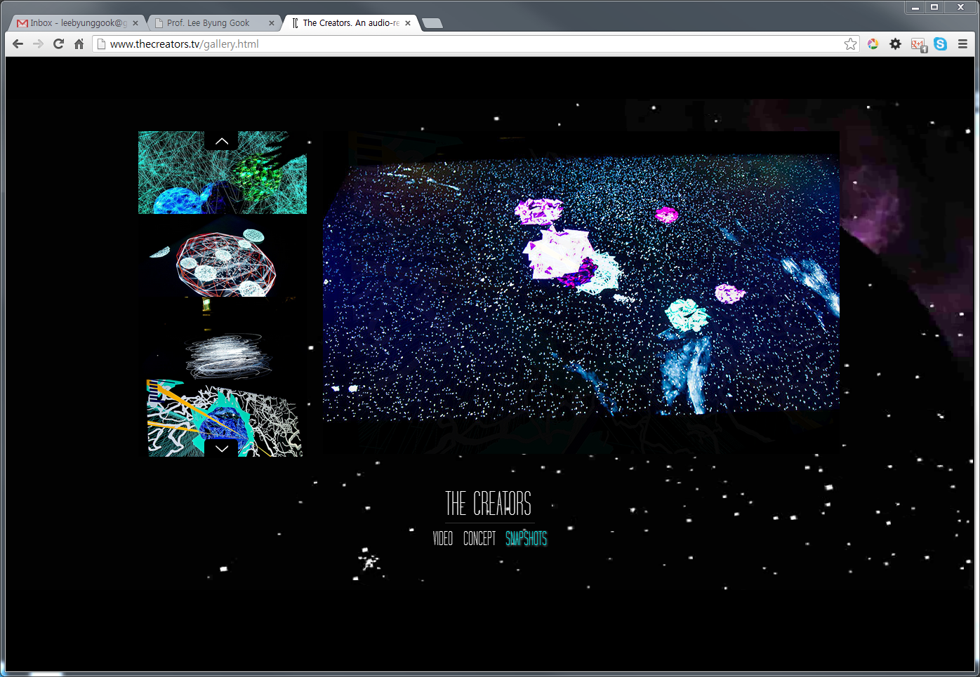
The Creators
by Constanza Casas, Mark C Mitchell and Pieter Steyaert
http://www.thecreators.tv/

Slide 19
How to set up?

Slide 20
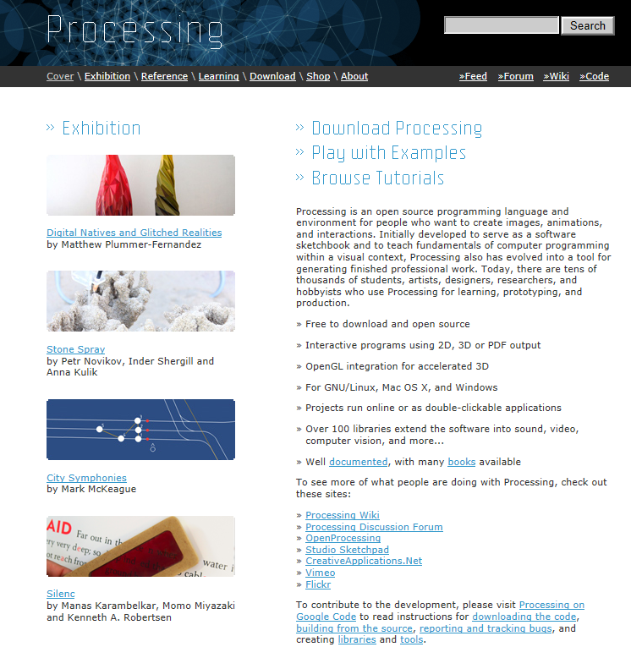
How to set up?
http://www.processing.org/

Slide 21
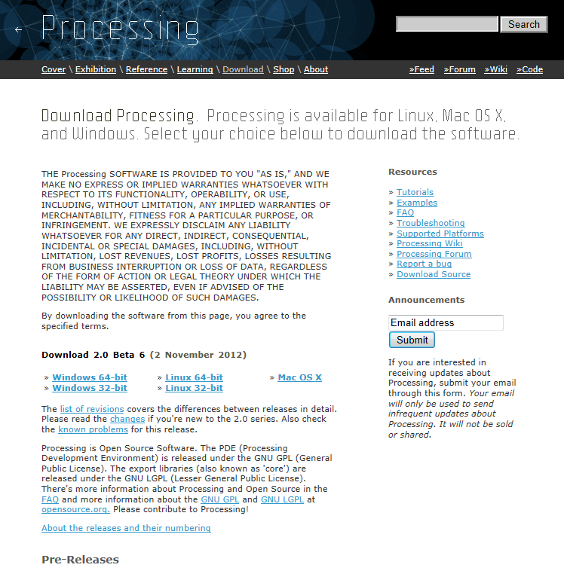
How to set up?
http://www.processing.org/

Slide 22
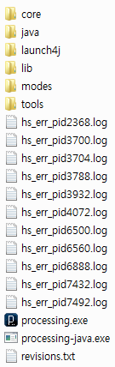

How to set up?
Is that all?!

Slide 23
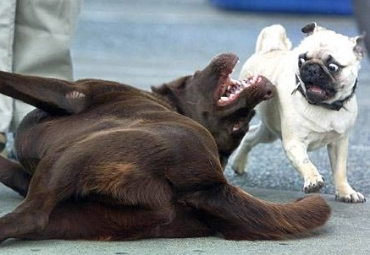
How to set up?
YES!!

Slide 24
Do it :
Simple example

Slide 25
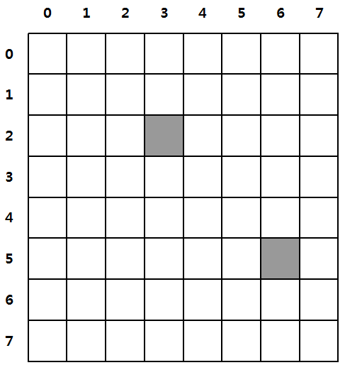
Do it: Simple example(Drawing)
Draw(Point)
Point
  point(x,y);
  point(3,2);
  point(6,5);

Slide 26
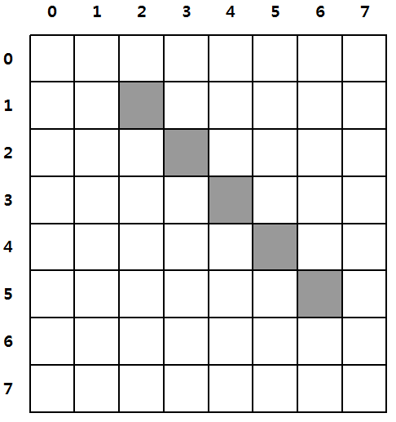
Do it: Simple example(Drawing)
Draw(Line)
Line
  line(x1,y1,x2,y2);
line(2,1,6,5);

Slide 27
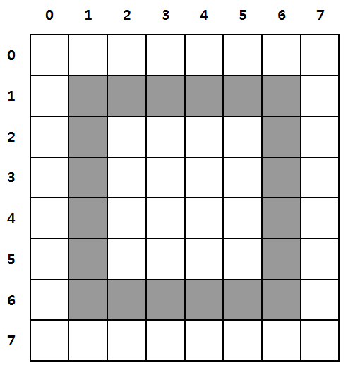
Do it: Simple example(Drawing)
Draw(Rectangle)
Just rect()
  rect(left, top, width, height);
  rect(1,1,6,6);

Slide 28
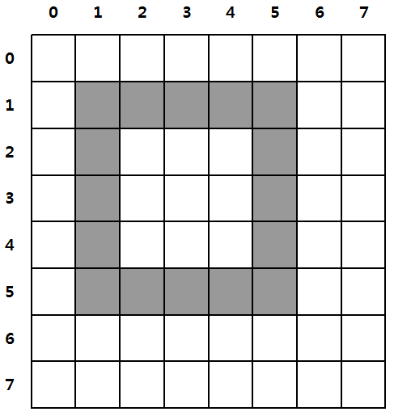
Do it: Simple example(Drawing)
Draw(Rectangle)
‘Center’ Mode
  rect(centerX, centerY, width, height);
rectmode(CENTER);
rect(3,3,5,5);

Slide 29
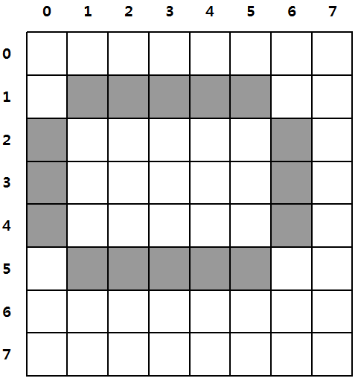
Do it: Simple example(Drawing)
Draw(Ellipse)
Just ellipse() = ellipse(CENTER)
  ellipse(centerX, centerY, width, height);
  ellipse(3,3,7,5);

Slide 30
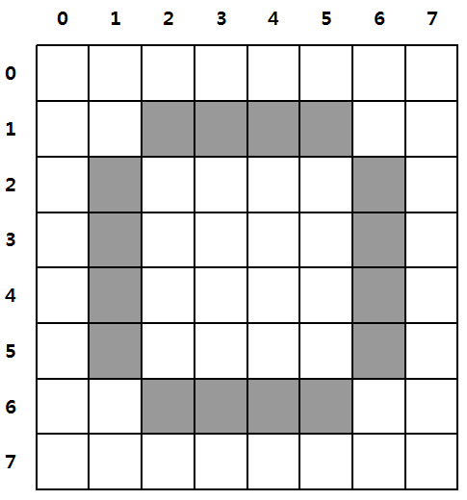
Do it: Simple example(Drawing)
Draw(Ellipse)
ellipse(CORNER)
  ellipse(Left, Top, width, height);
  ellipse(1,1,6,6);

Slide 31
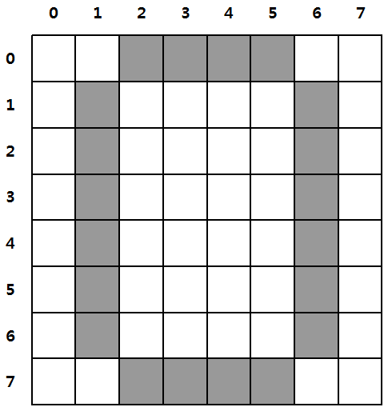
Do it: Simple example(Drawing)
Draw(Ellipse)
ellipse(CORNERS)
  ellipse(Left, Top, Right, Bottom);
  ellipse(1,0,6,7);

Slide 32
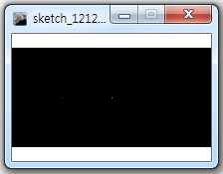
Do it: Simple example(Drawing)

Slide 33
Do it: Simple example(Drawing)
Draw point
  size(200,100);
  background(0,0,0);
  stroke(255,0,0);
  point(50,50);
  stroke(0,255,0);
  point(100,50);
  stroke(0,0,255);
  point(150,50);
Make sketch size like as inputted value
(ex. Width:200pixel, Height:100pixel)
Default : Width:100, Height:100

Slide 34
Do it: Simple example(Drawing)
Draw point
  size(200,100);
  background(0,0,0);
  stroke(255,0,0);
  point(50,50);
  stroke(0,255,0);
  point(100,50);
  stroke(0,0,255);
  point(150,50);
Make sketch background color like as
inputted value
(ex. Red:0, Green:0, Blue:0)
Default : Red:128, Green:128, Blue:128

Slide 35
Do it: Simple example(Drawing)
Draw point
  size(200,100);
  background(0,0,0);
  stroke(255,0,0);
  point(50,50);
  stroke(0,255,0);
  point(100,50);
  stroke(0,0,255);
  point(150,50);
Define to drawing color (Red, Green, Blue)
Red(255,0,0)
Green(0,255,0)
Blue(0,0,255)
Default color is black(0,0,0)

Slide 36
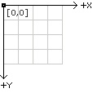
Do it: Simple example(Drawing)
Draw point
  size(200,100);
  background(0,0,0);
  stroke(255,0,0);
  point(50,50);
  stroke(0,255,0);
  point(100,50);
  stroke(0,0,255);
  point(150,50);
Draw point at inputted coordinate(x,y)
Left-Top is (0,0)
Pixel Coordinate

Slide 37
Do it: Simple example(Drawing)
Draw point
  size(200,100);
  background(0,0,0);
  stroke(255,0,0);
  point(50,50);
  stroke(0,255,0);
  point(100,50);
  stroke(0,0,255);
  point(150,50);

Slide 38
Do it: Simple example(Drawing)
Draw point
  size(200,100);
  background(0,0,0);
  stroke(255,0,0);
  point(50,50);
  stroke(0,255,0);
  point(100,50);
  stroke(0,0,255);
  point(150,50);

Slide 39
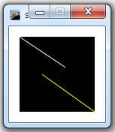
Do it: Simple example(Drawing)

Slide 40
Do it: Simple example(Drawing)
Draw line
  background(0,0,0);
  stroke(255,255,255);
  line(0,0,60,40);
  stroke(255,255,0);
  line(30,50,100,100);
Draw line function
(X1, Y1, X2, Y2)

Slide 41
Do it: Simple example(Drawing)
Draw line
  background(0,0,0);
  stroke(255,255,255);
  line(0,0,60,40);
  stroke(255,255,0);
  line(30,50,100,100);

Slide 42
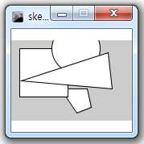
Do it: Simple example(Drawing)

Slide 43
Do it: Simple example(Drawing)
Draw Figure
size(150,100);
quad(61,60, 94,60, 99,83, 81,90);
rect(10,10,60,60);
ellipse(80,10,60,60);
triangle(12,50, 120,15, 125,60);
Draw quadrangle
(X1, Y1, X2, Y2, X3, Y3, X4, Y4)

Slide 44
Do it: Simple example(Drawing)
Draw Figure
size(150,100);
quad(61,60, 94,60, 99,83, 81,90);
rect(10,10,60,60);
ellipse(80,10,60,60);
triangle(12,50, 120,15, 125,60);
Draw rectangle
(X, Y, Width, Height)

Slide 45
Do it: Simple example(Drawing)
Draw Figure
size(150,100);
quad(61,60, 94,60, 99,83, 81,90);
rect(10,10,60,60);
ellipse(80,10,60,60);
triangle(12,50, 120,15, 125,60);
Draw ellipse
(CenterX, CenterY, Width, Height)

Slide 46
Do it: Simple example(Drawing)
Draw Figure
size(150,100);
quad(61,60, 94,60, 99,83, 81,90);
rect(10,10,60,60);
ellipse(80,10,60,60);
triangle(12,50, 120,15, 125,60);
Draw Triangle
(X1, Y1, X2, Y2, X3, Y3)

Slide 47
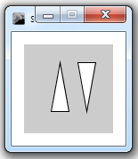
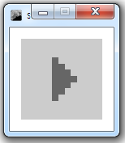
Do it: Simple example(Drawing)
Draw Figure
beginShape(TRIANGLES);
vertex(30, 75);
vertex(40, 20);
vertex(50, 75);
vertex(60, 20);
vertex(70, 75);
vertex(80, 20);
vertex(90, 75);
endShape( );
noStroke( );
fill(102);
beginShape(POLYGON);
vertex(38, 23);
vertex(46, 23);
vertex(46, 31);
vertex(54, 31);
vertex(54, 38);
vertex(61, 38);
vertex(61, 46);
vertex(69, 46);
vertex(69, 54);
vertex(61, 54);
vertex(61, 61);
vertex(54, 61);
vertex(54, 69);
vertex(46, 69);
vertex(46, 77);
vertex(38, 77);
endShape( );

Slide 48
Homework

Slide 49
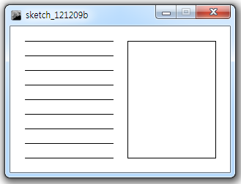
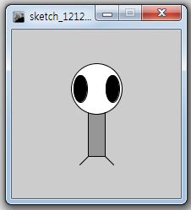
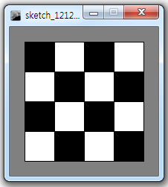
Homework

Slide 50
Q&
A

