Slide 1


신기술 세미나
Multimedia Engineering
Baek, Jong Hyun

Slide 2



Topic
IT Korea 5대 미래 전략
Dong Seo University Multimedia Engineering Baek, Jong Hyun

Slide 3
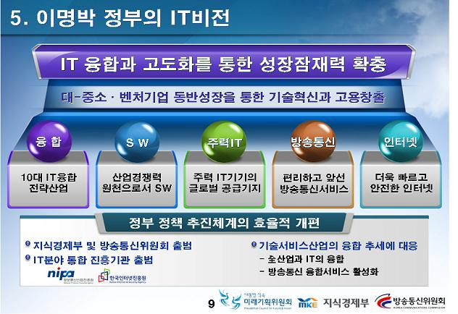
Detail
5대 전략 이란?
Dong Seo University Multimedia Engineering Baek, Jong Hyun

