Slide 1
Computer Grapics Project
Project Name-Birthday Cake
Team Name-Lee yu-na(20091719)
-Sin min-jea(20091693)
Bae jin-seong

Slide 2
Table Of Contents
TeamName Of Member
Development Object
Development Environment
Project Summary
Improvement Plan
Reference Data
Project Sorce Code Exe

Slide 3
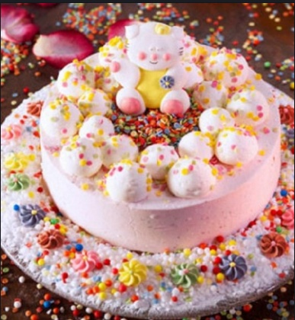
TeamName Of Member
TeamName
->S.F
Member
->Lee yu na(20091719)
->Sin min-jea(20091693)
->Bae jin
seong

Slide 4
Development Object
Graphics About Understanding
Graphics Scale Expand
Team Project About Skill Improve
Team Member Skill Improve

Slide 5
Development Environment
OS – Window 7
TOOL - Visual Studio 2008
Library – OPENGL (GLUT)

Slide 6
Project Summary
Cake Realization
Triple Cake Realization
Cake Above Candle Realization
Dolls Dancing Realization
Various Light Color Realization
Cake Rotation Realization

Slide 7
Improvement Plan
Graphics About Understanding
OpenGL About Interesting
Various Skill Realization Shortage
Full of Patriotic Effort

Slide 8
Reference Data
WWW.KOWON.DONGSEO.AC.KR/~LBG
WWW.NAVER.COM
WWW.GOOGLE.CO.KR

Slide 9
Project Sorce Code Exe
소스(하이퍼링크)
소스에 같이 포함될 소스
압축파일

Slide 10
END

