Slide 1
Computer Graphics Proj.
Impact! (Dodge 3D ver.)
Digital Contents
Game Major - Senior
20052191 - Hong Seok Min

Slide 2
Table of contents
Development tools
Introduction of ‘Impact’
Reference information

Slide 3


Development tools
Visual Studio 2005 C++
OpenGL
FMOD (Sound lib.)

Slide 4
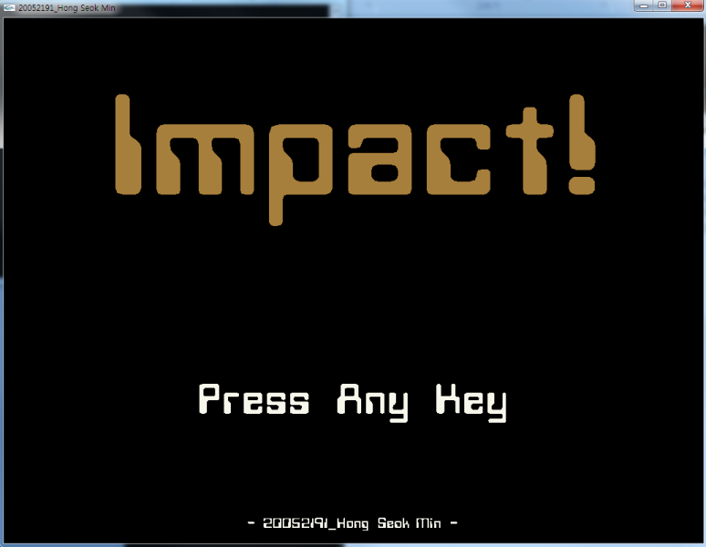
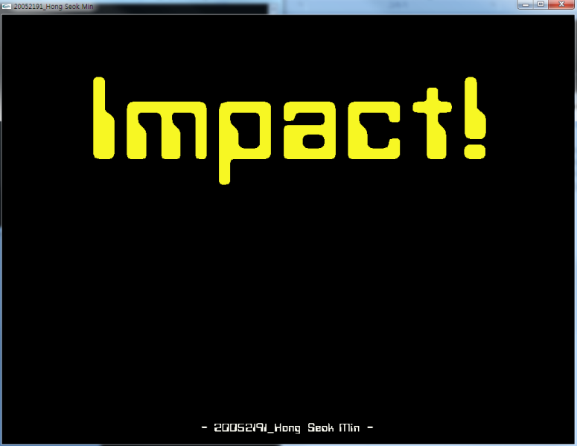
Introduction of ‘Impact’
Main Mode
  Title ‘Impact!’ is flickering with 14 colors
  Sub title ‘Press Any Key’ is flickering every sec.

Slide 5
Introduction of ‘Impact’
Game Mode
  Terrain
  Fog
  Wallpaper
  A lot of enemies (total 80)
  Each enemy unit to random position

Slide 6
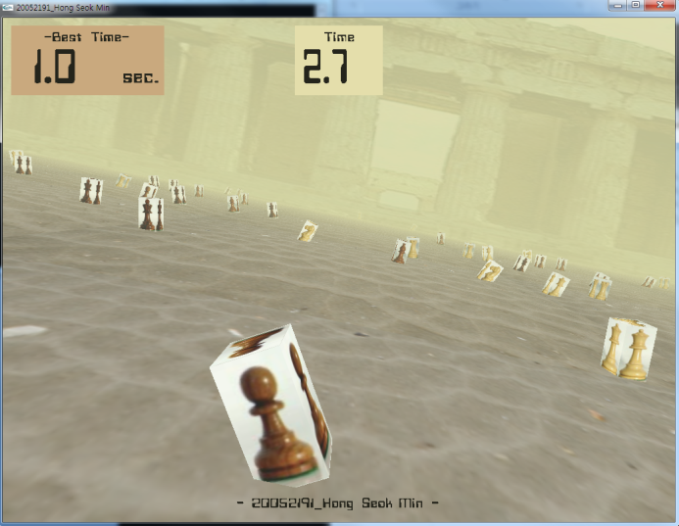
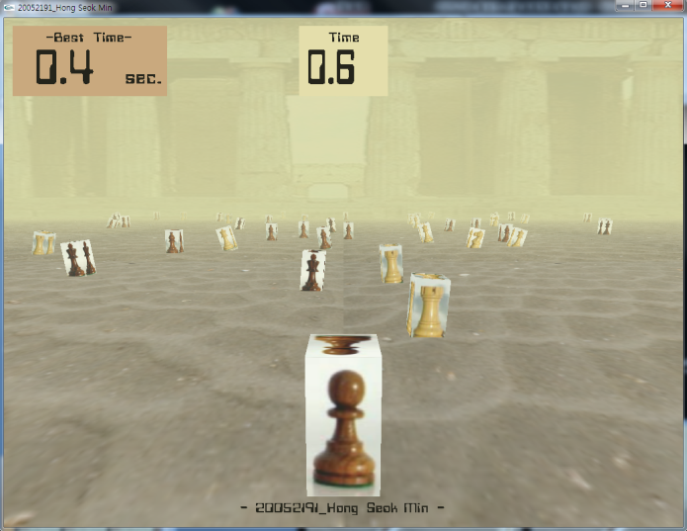
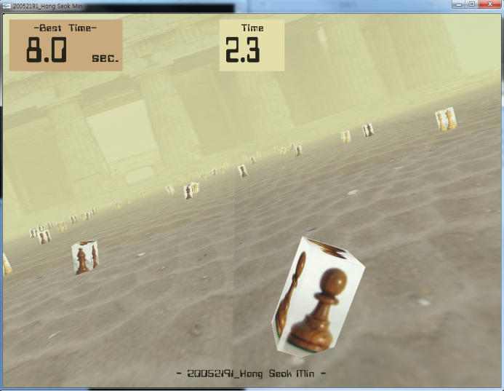
Introduction of ‘Impact’
Game Mode
  Use texture mapping
  Rotate my unit for each direction (Left, Right)
  No input, my unit moves to normal (Middle)
Left
Middle
Right

Slide 7
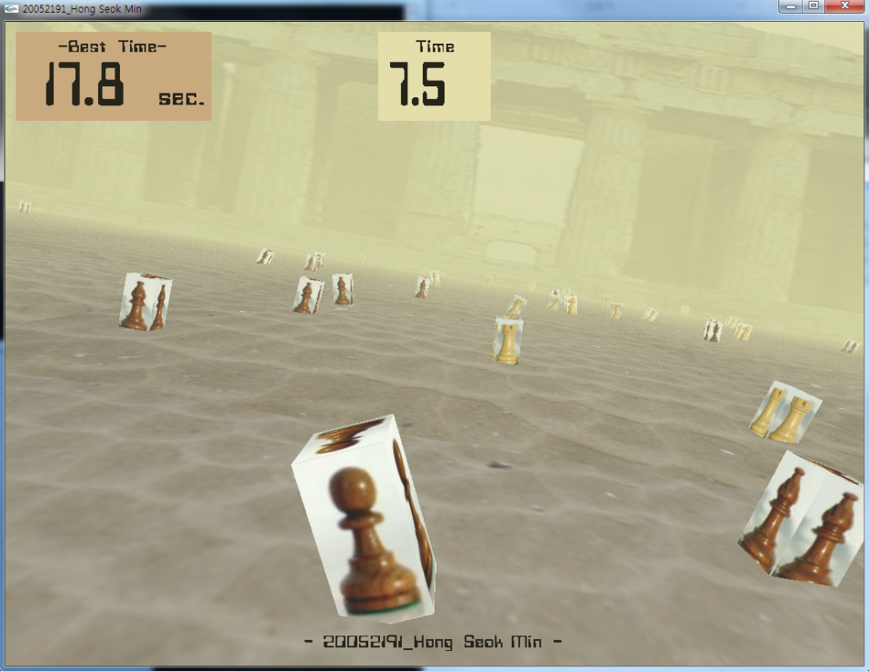
Introduction of ‘Impact’
Game Mode
  Renewing a new record time
  Player can see his record time with play
Best
time
Record
time

Slide 8
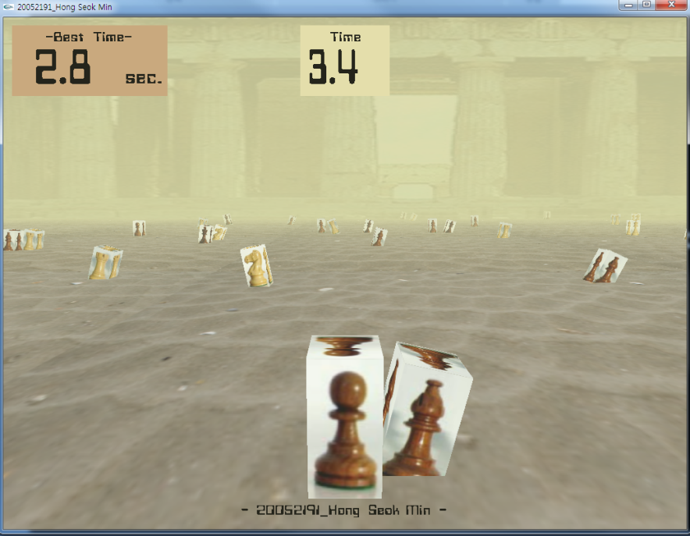
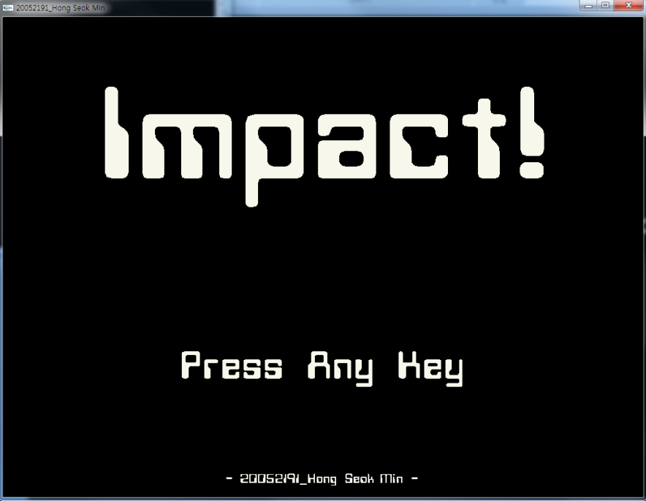
Introduction of ‘Impact’
Game Mode
  When it crashed, game is over
  Change to main mode & renewing new record

Slide 9
Reference Information
FMOD (Sound lib.)
  http://www.fmod.org/ (Official home page)
  http://novas86.blog.me/10072004834 (How to use)

